Slide 1

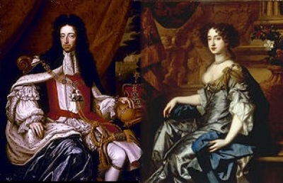
Conflict and Absolutism in Europe
Ch 18.2 War and Revolution in England
Text Dependent Essential Question: How did disagreements over rule between the Stuarts and Parliament lead to the English Civil War? What were the causes and effects of the Glorious Revolution?

Slide 2
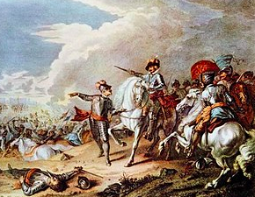
Revolutions in England
17th century – In addition to the Thirty Years' War, a series of rebellions & civil wars rocked Europe
Most famous struggle was the civil war in England or English Revolution
The war was between King & Parliament to determine what role each should play in governing England.
Finally reached a resolution only after another revolution later in the century
Text Dependent Essential Question: How did disagreements over rule between the Stuarts and Parliament lead to the English Civil War? What were the causes and effects of the Glorious Revolution?

Slide 3
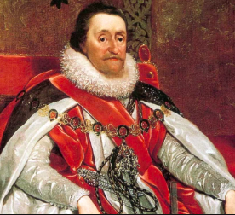
Revolutions in England:
The Stuarts and Divine Right
1603 – The Tudor dynasty ended with the death of Queen Elizabeth I.
When the King of Scotland, Elizabeth's cousin, ascended the English throne & became James I, the Stuart line of rulers began.
James believed he received his power from & was only responsible to God (The Divine Right of Kings)
Parliament didn’t think much of the divine right of kings – assumed that the monarch & Parliament ruled England together.
Text Dependent Essential Question: How did disagreements over rule between the Stuarts and Parliament lead to the English Civil War? What were the causes and effects of the Glorious Revolution?

Slide 4
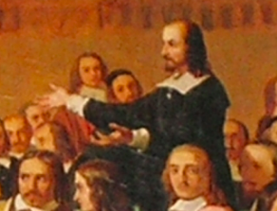
Revolutions in England:
The Stuarts and Divine Right
Religion was an issue as well.
Puritans: Protestants in England inspired by Calvinist ideas didn’t like the king's strong defense of Church of England.
While they were members of the Church of England, Puritans wished to remove any remaining resemblances to Catholicism from their church.
Many of England's gentry, mostly well-to-do landowners, had become Puritans.
Puritan gentry formed an important part of The House of Commons, the lower house of Parliament. It wasn’t wise to alienate them.
Text Dependent Essential Question: How did disagreements over rule between the Stuarts and Parliament lead to the English Civil War? What were the causes and effects of the Glorious Revolution?

Slide 5
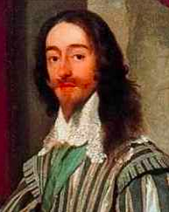
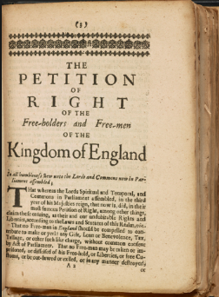
Revolutions in England:
The Stuarts and Divine Right
Conflict that began during James’ reign came to a head during the reign of his son, Charles I, who also believed in the divine right of kings.
1628 – Parliament passed a Petition of Right.
The petition placed limits on the King's ability to tax, imprison citizens without cause, quarter troops & institute martial law.
Charles initially accepted this petition, later realized the limits it put on his power & ignored it.
He tried to impose more ritual on Church of England.
1000s of Puritans didn’t accept his policy & went to America
Text Dependent Essential Question: How did disagreements over rule between the Stuarts and Parliament lead to the English Civil War? What were the causes and effects of the Glorious Revolution?

Slide 6
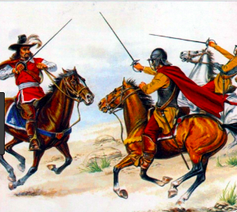
Revolutions in England:
Civil War and Commonwealth
Complaints grew until 1642, when England slipped into a civil war between supporters of King (Cavaliers or Royalists) & parliamentary forces (The Roundheads).
Due to the New Model Army of Oliver Cromwell, a military genius, Parliament proved victorious
The New Model Army chiefly consisted of more extreme Puritans, called The Independents, who believed they were doing battle for God.
Due to Cromwell the soldiers were well-disciplined & trained in the new military tactics of 1600s.
Text Dependent Essential Question: How did disagreements over rule between the Stuarts and Parliament lead to the English Civil War? What were the causes and effects of the Glorious Revolution?

Slide 7
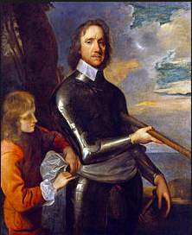
Revolutions in England:
Civil War and Commonwealth
The victorious New Model Army quickly took control.
Cromwell purged Parliament of any members who hadn’t supported him.
What was left, the Rump Parliament, executed Charles I on Jan 30, 1649 → horrified much of Europe.
Parliament next abolished Monarchy & House of Lords,
declared England a commonwealth, a type of republic
Cromwell found it difficult to work with the Rump Parliament → finally dispersed it by force
After destroying both King & Parliament Cromwell set up a military dictatorship.
Text Dependent Essential Question: How did disagreements over rule between the Stuarts and Parliament lead to the English Civil War? What were the causes and effects of the Glorious Revolution?

Slide 8
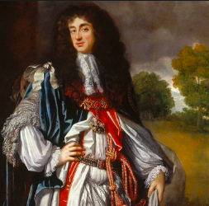
Revolutions in England:
The Restoration
Cromwell ruled until his death in 1658.
1660 – Army realizing how unpopular it had become restored the monarchy with Charles II, son of Charles I.
Restoration of the Stuart monarchy or the Restoration period didn’t undo the work of the English Revolution.
Parliament kept much of the power it had won & continued to play an important role in government. It was also accepted that, Parliament must give its consent to taxation.
But, Charles continued to push his own ideas. Some were clearly out of step with many of English people
Text Dependent Essential Question: How did disagreements over rule between the Stuarts and Parliament lead to the English Civil War? What were the causes and effects of the Glorious Revolution?

Slide 9
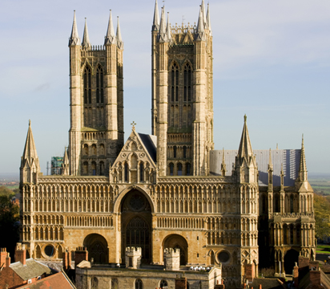
Revolutions in England:
The Restoration
Charles was sympathetic to Catholicism, since James, his brother & heir to the throne was a Catholic.
After the restoration of the monarchy Parliament had passed laws against Catholics & Puritans
Charles took the bold step of suspending the laws which aroused Parliament's suspicions about Kings Catholic leanings → Parliament forced the King to back down.
Driven by a strong anti-Catholic sentiment Parliament then passed A Test Act – specifies that only Anglicans (members of the Church of England) could hold military & civil offices.
Text Dependent Essential Question: How did disagreements over rule between the Stuarts and Parliament lead to the English Civil War? What were the causes and effects of the Glorious Revolution?

Slide 10
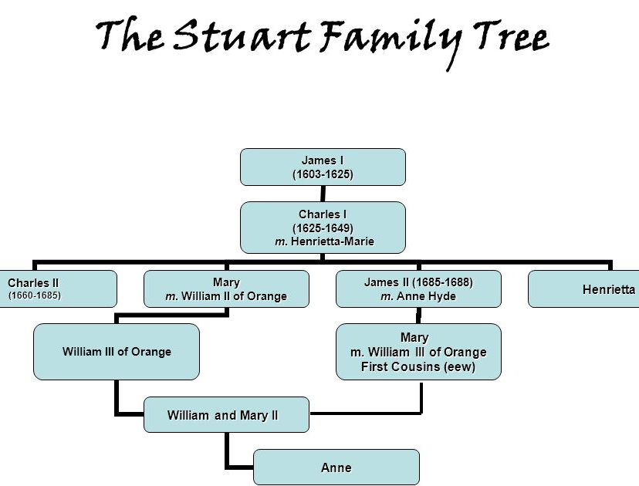
Revolutions in England:
The Restoration
On his deathbed Charles II had decided to convert to Catholicism → aroused more suspicion
1685 – After Charles died without a son, James II became King. He was an open & devout Catholic.
He named Catholics to high positions in government, army, navy & universities.
Again, Religion caused conflict between King & Parliament. Parliament objected to James's policies
They didn’t rebel, since members knew he was an old man & his Protestant daughters: Mary & Anne, born to his first wife, would succeed him
1688 – But then, James & his second wife, a Catholic, had a son → possibility of a Catholic monarchy loomed
Text Dependent Essential Question: How did disagreements over rule between the Stuarts and Parliament lead to the English Civil War? What were the causes and effects of the Glorious Revolution?

Slide 11
Conflict and Absolutism in Europe
Ch 18.2 War and Revolution in England
Text Dependent Essential Question: How did disagreements over rule between the Stuarts and Parliament lead to the English Civil War? What were the causes and effects of the Glorious Revolution?

Slide 12
Revolutions in England:
A Glorious Revolution
A group of English nobles invited William of Orange, the Dutch Leader, to invade England, informing him that most of the kingdom's people wanted a change.
The invitation put William & his wife Mary, the daughter of James II, in a difficult position
It would be appalling for Mary to rise up against her father.
But, William, a foe of France's Catholic king Louis XIV – welcomed this opportunity to fight France with England's resources.
Text Dependent Essential Question: How did the Glorious Revolution affect the political landscape and power base in England?

Slide 13
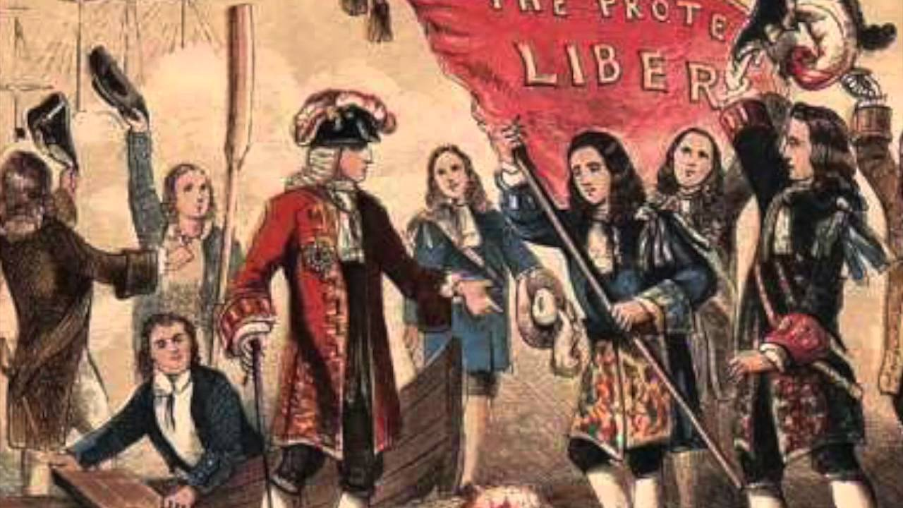
Revolutions in England:
A Glorious Revolution
Early 1688 – William began making preparations to invade England. But James realized William's intentions only in Oct.
Nov 1688 – William's forces landed at Torbay & began their march toward London. James responded by sending forward his army.
Many of his soldiers, his daughter Anne & her husband deserted him → James retreated to London and made plans for his wife & son to flee to France where James later joined them.
With almost no bloodshed, England had undergone a “Glorious Revolution”
Text Dependent Essential Question: How did the Glorious Revolution affect the political landscape and power base in England?

Slide 14
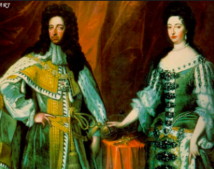
Revolutions in England:
A Glorious Revolution
Jan 1689 – Parliament offered the throne to William & Mary. They accepted it, along with a Bill of Rights which was similar to Petition of Right.
The Bill of Rights set forth Parliament’s right to make laws & to levy taxes.
It stated that standing armies could be raised only with Parliament's consent → made it impossible for kings to oppose or to do without Parliament.
It confirmed the rights of citizens to keep arms & to have a jury trial
It helped create a system of government based on the rule of law & a freely elected Parliament.
It laid the foundation for a limited or constitutional monarchy.
Text Dependent Essential Question: How did the Glorious Revolution affect the political landscape and power base in England?

Slide 15
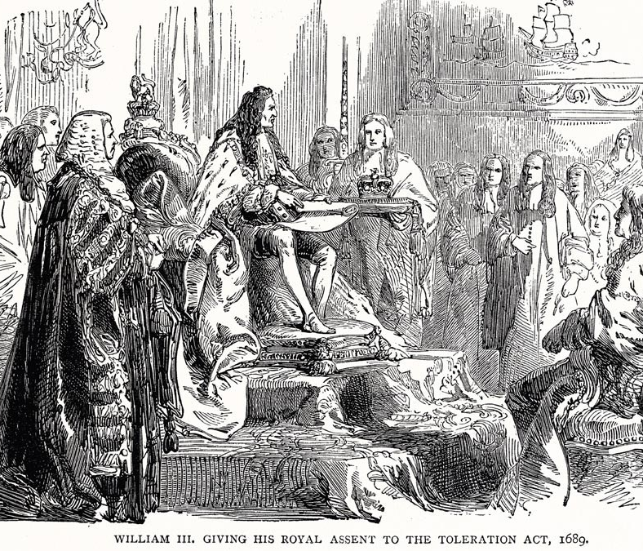
Revolutions in England:
A Glorious Revolution
Toleration Act of 1689 –action of Parliament which granted Puritans, but not Catholics, right of free public worship.
English citizens wouldn’t be persecuted for Religion → Marked a turning point in English history
Parliament had destroyed the Divine-Right Theory of Kingship by deposing one king & establishing another. William was King, not by Grace of God, but by the grace of Parliament
It had asserted its right to be part of the government.
It didn’t have complete control of government but had right to participate in affairs of state.
Over next century, it gradually proved to be the real authority in English system of constitutional monarchy.
Text Dependent Essential Question: How did the Glorious Revolution affect the political landscape and power base in England?

Slide 16
Conflict and Absolutism in Europe
Ch 18.2 War and Revolution in England
Charles V Crash Course (13 mins)
Text Dependent Essential Question: How did disagreements over rule between the Stuarts and Parliament lead to the English Civil War? What were the causes and effects of the Glorious Revolution?

Slide 17
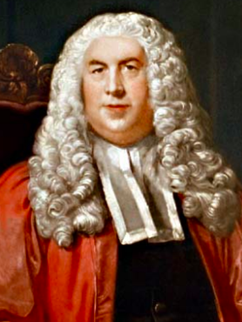
Legal and Political Thought
English legal and political thought reflected concerns with Order & Power.
William Blackstone, a judge & professor of law wrote Commentaries on the Laws of England,
He argued political stability could be achieved by a revived emphasis on English common law.
Text Dependent Essential Question: How did disagreements over rule between the Stuarts and Parliament lead to the English Civil War? What were the causes and effects of the Glorious Revolution?

Slide 18
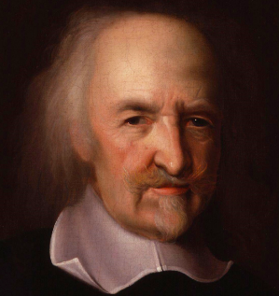
Legal and Political Thought
Thomas Hobbes, political thinker, alarmed by the revolutionary upheavals in England
1651 –published the political work Leviathan to deal with problem of disorder.
Hobbes argued before organized society, humans were guided not by reason & moral ideals, but by a ruthless struggle for self-preservation.
To save themselves from destroying one another people made a social contract & agreed to form a state, which Hobbes called “that great LEVIATHAN . . . to which we owe . . . our peace and defense”
People in the state agreed to be governed by an absolute ruler with unlimited power, in order to suppress rebellion & preserve order.
Text Dependent Essential Question: How did disagreements over rule between the Stuarts and Parliament lead to the English Civil War? What were the causes and effects of the Glorious Revolution?

Slide 19
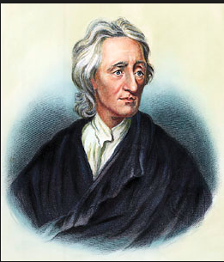
Legal and Political Thought
John Locke, a political thinker, viewed the exercise of political power differently.
1690 – published his Two Treatises of Government – argued against the absolute rule of one person.
Unlike Hobbes, Locke believed before society was organized, humans lived in a state of equality & freedom rather than in a state of war
So, all humans had certain natural rights: rights with which they were born. These included: rights to life, liberty & property.
Text Dependent Essential Question: How did disagreements over rule between the Stuarts and Parliament lead to the English Civil War? What were the causes and effects of the Glorious Revolution?

Slide 20
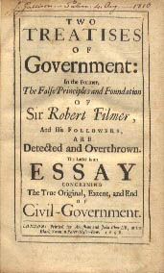
Legal and Political Thought
But like Hobbes, Locke believed people found it difficult to protect their natural rights
Thus, they agreed to establish a government to ensure the protection of their rights & to judge those who violated them.
Government would protect the rights of the people & the people would act reasonably.
But, if a government broke the contract for e.g., If a monarch failed to protect citizens' natural rights people would use their rights to alter or remove & form a new government.
Text Dependent Essential Question: How did disagreements over rule between the Stuarts and Parliament lead to the English Civil War? What were the causes and effects of the Glorious Revolution?

Slide 21
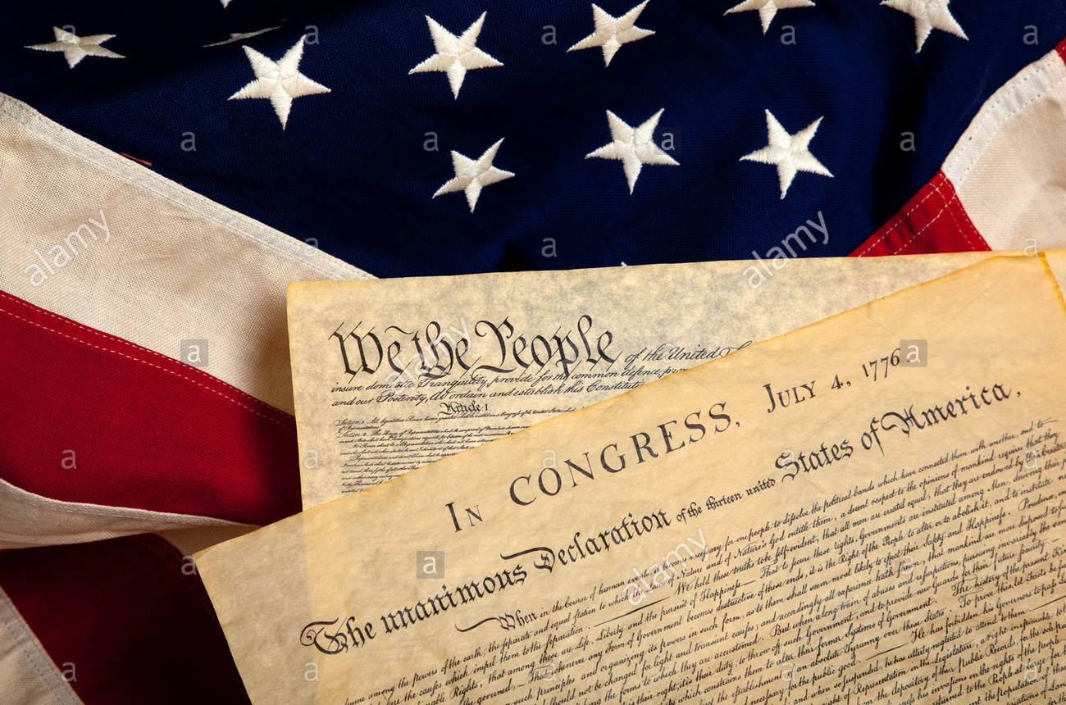
Legal and Political Thought
To Locke, people meant the landholding aristocracy.
He was not an advocate of democracy
But his ideas proved important in 18th century
used to support demands for constitutional government, the rule of law & the protection of rights.
Locke's ideas can be found in both the American Declaration of Independence & the United States Constitution.
Text Dependent Essential Question: How did disagreements over rule between the Stuarts and Parliament lead to the English Civil War? What were the causes and effects of the Glorious Revolution?

Slide 22
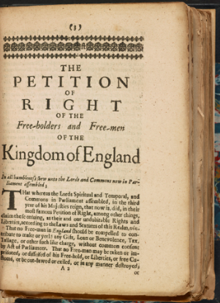
Close Reading of a Primary Source:
Petition of Right
Preparation: Find a text
1st Reading: read & annotate
1st Reading: discussion
2nd Reading: set purpose with text
dependent question (TDQ)
5. 2nd Reading: Discussion:
6. Writing: respond to the TDQ
TDQ: Based on these excerpts, what is the tone of the petition? Give examples of language that reflects that tone. Why do you think the members of Parliament who wrote the petition used that tone?

Slide 23
Conflict and Absolutism in Europe
Ch 18.2 War and Revolution in England
Charles V Crash Course (13 mins)
Text Dependent Essential Question: How did disagreements over rule between the Stuarts and Parliament lead to the English Civil War? What were the causes and effects of the Glorious Revolution?

