Slide 1


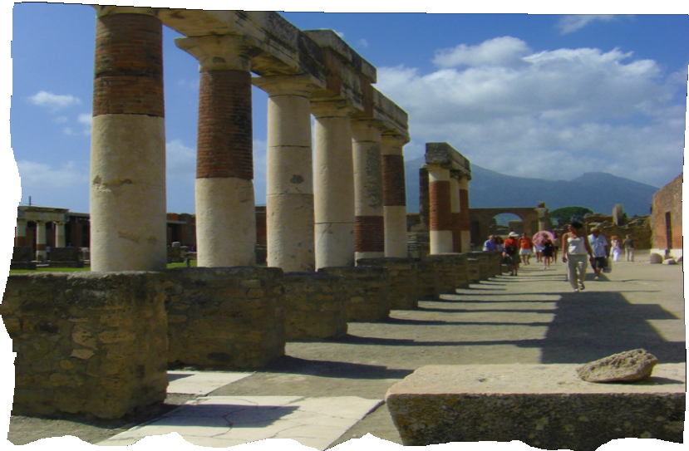

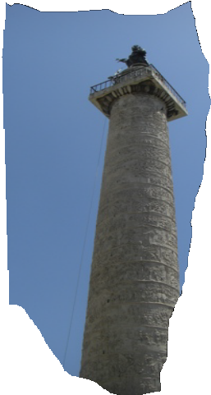


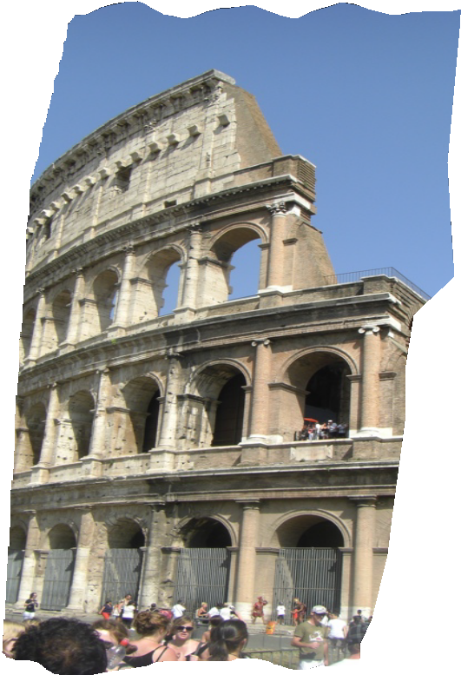

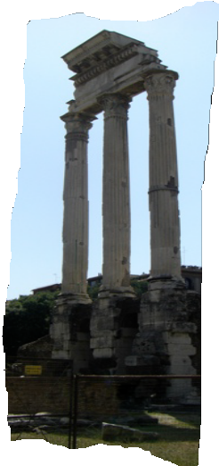

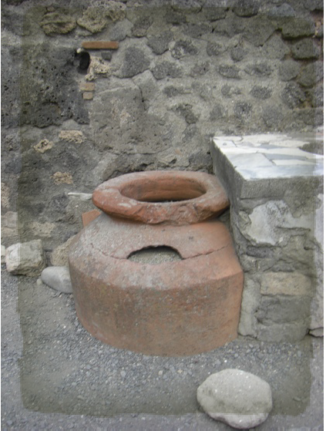
FROM REPUBLIC TO EMPIRE II
LESSON 8
ROMAN
EMPIRE
AUGUSTUS TRANSITIONS THE REPUBLIC TO EMPIRE
PAGE
1

Slide 2
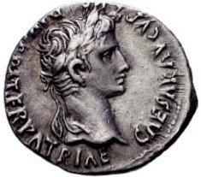
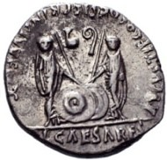
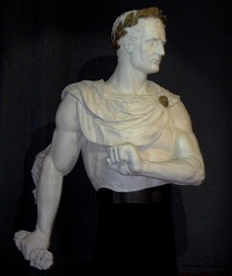
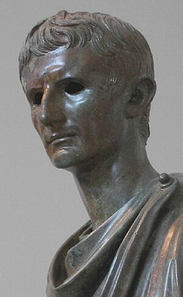
Romans!
FROM REPUBLIC TO EMPIRE II
LESSON 8
How Did Augustus Transition Rome from Republic into an Empire?
Augustus=Octavian!
Caesar Augustus Circa 2 B.C.-5 A.D.
Caesars with hands on shields and spears
Caesar had won major victories in Spain. He was
a hero and treated like a king and god. He named one of his generals as his heir, Octavian, Marius’ relation and Caesar’s great-nephew. He even had coins minted with Octavian’s image on them. His policy of forgiving a percentage of all people’s debts made him extremely popular with the people, but this infuriated the Senate.
The Roman Senate was not ready to give up their power and certainly did not think they wanted to have a king. However, Caesar dressed in purple and sat on a golden throne, while wearing a crown of laurels, like a king, everywhere he went. A dictator for life was fine, but the Senate could not stomach the idea of a king, so they formulated a plan. 60 senators waited for Julius Caesar on the 15th of
Julius Caesar in laurels.
March (known as the Ides of March). Hidden in their cloaks were
knives. The Senators waited for him and stabbed him at least one time each, so that they were all to blame. But the conspirators had no plans on how they were going to take
control of Rome, an empire already under the control of one man. The
Senators wanted to return Rome to the Republic it had once been, but the Roman people were not happy and instead grew into violent mobs fired up by Caesar’s general Marcus Antonius (Marc Antony)
(Let’s get the name of the next man out of the way now: Octavian = Augustus. Octavian is given the name “Augustus” by the Senate, which means Revered One, in 27 B.C.)
Octavian was a minor player on the Roman stage until he went to Spain to meet up with his great uncle, Julius Caesar. He only played a minor role while in Spain, but soon, he and his best friend, Marcus Vipsanius Agrippa, were sent off to Greece to further their education. Caesar picked Octavian to be his second in command in Rome in the year 43
B.C. at the age of only 20, but it did not work out because Caesar was
Young Octavian

Slide 3
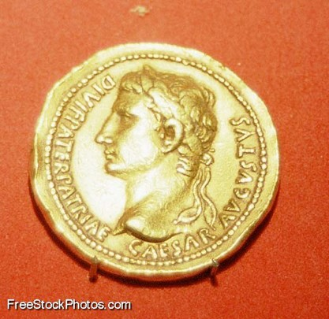
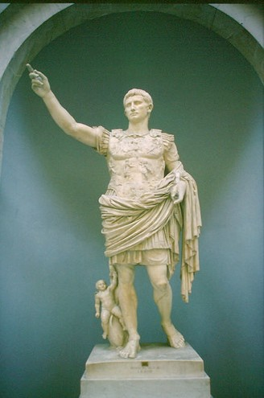
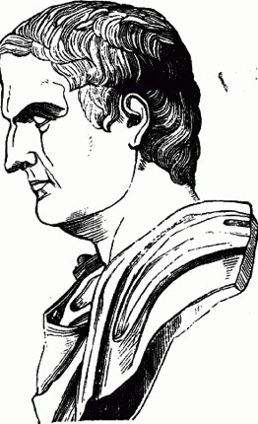
FROM REPUBLIC TO EMPIRE II
LESSON 8
Gold coin of Augustus Caesar
killed!
Octavian, taking the name of Gaius Julius Caesar Octavian, was able to lead many of the troops loyal to his great uncle and suddenly gained military power. The Senate forced Antony to flee and they snubbed an “expendable” Octavian. So the two men joined forces with the Governor of Spain and Caesar’s old General, Lepidus and formed the second triumvirate. Octavian was able to maneuver Lepidus into taking a position in Northern Africa and he and Antony split the empire.
Octavian took the west and defeated many uprisings in Gaul and Spain. Meanwhile, Antony reconquered the
East, with the help of his new bride, Cleopatra, an Egyptian queen. The Senate was shocked that Antony had a non-Roman bride. Octavian, taking advantage of this situation, “found” a will that was supposed to belong to Antony, which claimed that his son with Cleopatra was the heir to the throne and that he wanted to be buried in Egypt! The Senators were scandalized! Not only had Antony married a foreigner but, supposedly, he wanted his non-Roman son to be the leader of Rome. Off the Greek waters, Antony and Cleopatra’s ships attacked Octavian’s. Octavian won and Cleopatra and Antony fled to Egypt. They lost the war and committed suicide. Antony stabbed himself to death, while the chief priest in Egypt brought a poisonous asp to bite Cleopatra.
Octavian was total ruler by 30 B.C. He ruled for 41 years, by far longer than any other Roman ruler to that time. He made changes and over the course of his rule,
these changes became permanent. He had gained power by paying the military well, feeding the
masses with inexpensive grain, and by making sure that the wealthy elite were also given favorable financial status. The more that the elite cooperated, the better off they were. He fired the greedy and corrupt governors and put good men in charge of the provinces, who reduced taxes and ended giving away property illegally. His public works were incredible, because they were made of marble and he paid for much of them himself. Augustus brought stability to the economy and to the empire. People wanted stability and security. He secured the borders against invaders in Gaul (France),
Powerful Augustus Caesar
Marcus Antonius
(Marc Antony)

Slide 4
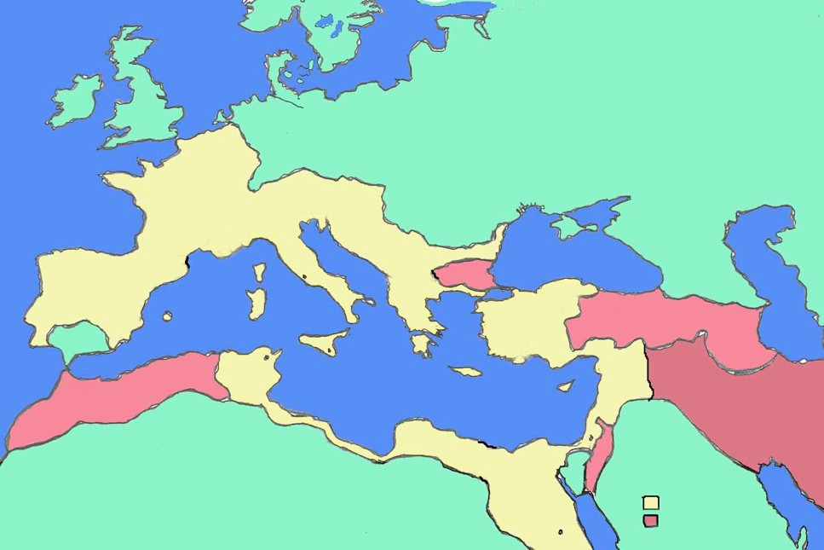
FROM REPUBLIC TO EMPIRE II
LESSON 8
Spain, Germania, Parthia (Mesopotamia), and southern Africa. Peace, stability and severe restriction against corruption brought Augustus love and adoration from Rome and respect and tolerance from the rest of the restless empire.
Rhine River
Germanic Tribes
Gaul
Danube River
Rome
Thrace
Spain
Greece
Anatolia
Pontus
Armenia
Carthage
Syria
Mauretania
Egypt
Roman Empire at 14 A.D. Parthian Empire
Student Name: Lesson Completed on / /
minted: laurels: formulated: Ides of March: Octavian: triumvirate:
1. Julius Caesar was killed on the Ides of March. What do you think it means if a person today says, “Beware the Ides of March” to someone?

Slide 5
FROM REPUBLIC TO EMPIRE II
LESSON 8
2. Why did the Senate give Octavian the name Augustus? What accomplishments did Octavian have that could be used as examples for Octavian deserving this title?
3. Why do you think that the rest of the empire tolerated Augustus? Would you have toler- ated him as a ruler if you were not Roman? Why?
4. Who do you think was the first Emperor of Rome? Why?
5. Draw four of the above bolded vocabulary words in the boxes below.

