Slide 1
Christmas Picture Finds
Use the shapes toolbar above and choose the circle. Click and hold the mouse where you want to start the circle, and then release to end the circle. Click the circle to move it as needed. Put a circle on all of the items from the key beneath the picture. All of those items are hidden in the image somewhere! Good Luck!
Here is a picture of the shapes toolbar:

Slide 2
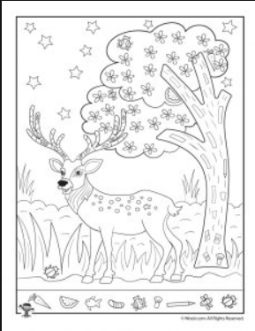

Slide 3
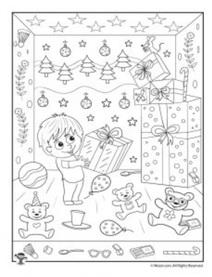

Slide 4
